Slide 1
Dynamic Assessment and Implementation of the Extempore and VEO Apps
Olga Thomason
University of Georgia

Slide 2
Dynamic Assessment
L.S. Vygotsky and other supporters of the Socio-cultural theory (e.g., Leontiev, El’konin, Gal’perin, and Davydov) => research for tracing learners’ intellectual development
L.S. Vygotsky’s theory of mental development with the focus on the concept of the Zone of Proximal Development:
human learning is socially mediated by appropriate types of guidance provided at appropriate times as learners attempt to carry out learning tasks
tests themselves provide opportunities for learning to occur and therefore instruction or mediation should be built into testing procedures.
development is not always smooth and straightforward. It can occur at changing rates and can include not only progressive but also regressive moves
The microgenetic method: “the reorganization and development of mediation over a relatively short span of time” (Lantolf, 2000:3)

Slide 3
RUSS3911 Tutorial in Professional Russian
content-based and covers several areas where global professionals regularly have to communicate in Russian
a multi-disciplinary approach (e.g., international affairs, ecology, economics, journalism, and other fields)
designed for the intermediate-mid, intermediate-high students who desire to reach the advanced-level

Slide 4
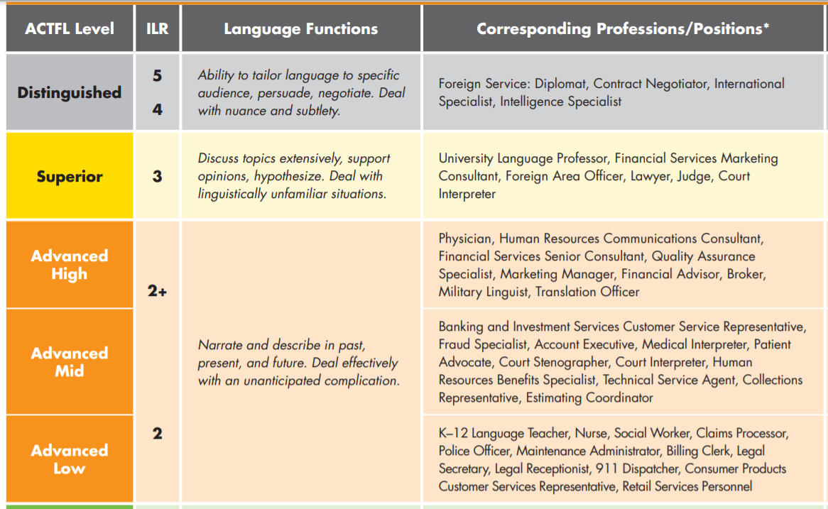
RUSS3911 Tutorial in Professional Russian
https://www.actfl.org/sites/default/files/guidelines/OralProficiencyWorkplacePoster.pdf

Slide 5
Extempore https://extemporeapp.com/
A language learning platform that targets students’ speaking and comprehension skills
Mobile versions are available
User-friendly
Various levels of assessments’ control
Tools for individualized instructor’s feedback
Secure assessments

Slide 6
Extempore https://extemporeapp.com/
Sequence of tasks (similar, but not the same)
Assessment 1: 5 questions in a written form => 30 seconds to prepare after each question => 1 minute to answer each question
Assessment 2: 5 questions in an oral form => 30 seconds to prepare after each question => 1 minute to answer each question
Assessment 3: A visual stimulus => 1 minute to prepare a narration + 3-5 helping questions in a written form => 3 minutes to narrate

Slide 7
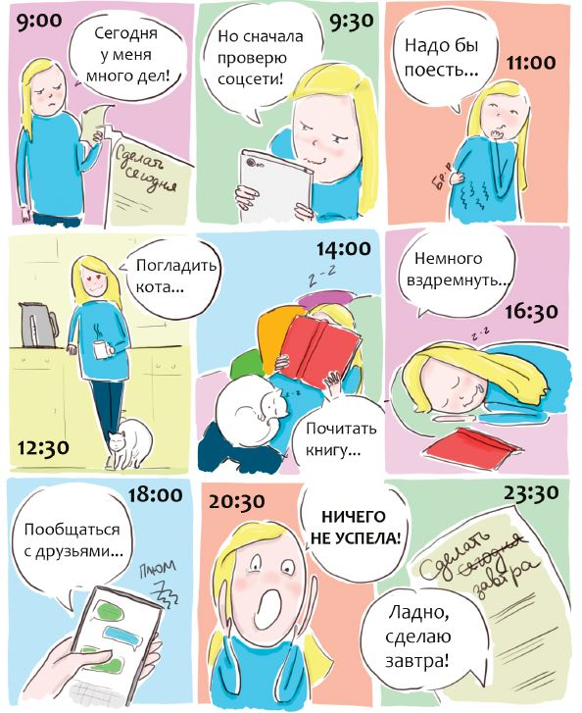
Здоровье и образ жизни: прокрастинация
Assessment 1
Assessment 2
Assessment 3
Что делает человек, когда занимается прокрастинацией?
По каким причинам люди прокрастинируют?
Как себя обычно чувствуют люди, когда они прокрастинируют?
Вы когда-нибудь прокрастинировали? Когда и почему?
Как можно бороться с прокрастинацией?
Что такое прокрастинация?
Из-за чего случается прокрастинация?
Как влияет прокрастинация на самочувствие человека?
Что произошло, когда вы прокрастинировали в последний раз?
Что вы посоветуете друзьям, которые часто занимаются прокрастинацией?
Просмотрите комикс. Расскажите, что случилось с девушкой и почему? Как вы думаете, какую проблему этот комикс иллюстрирует? Как вы посоветуете решить эту проблему?

Slide 8
Здоровье и образ жизни: прокрастинация

Slide 9
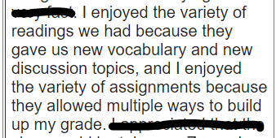
Extempore https://extemporeapp.com/
Evaluations:

Slide 10
VEO https://veo.co.uk/
Video tagging software for evaluation of students’ oral presentations
Easy-to-use platform
Ability to tag and comment on errors and improvements
Ability to create rubrics/categories for tagging
Ability to give individualized detailed feedback on students’ performance
Useful tool for collaboration as several students/tutors/instructors can tag and comment on the same video
Useful statistics that help students keep track of their progress

Slide 11
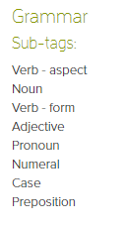
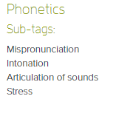
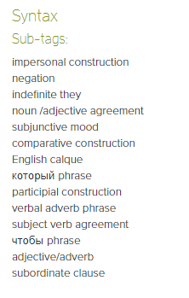
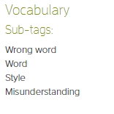
VEO https://veo.co.uk/
Tag sets:

Slide 12
VEO https://veo.co.uk/

Slide 13
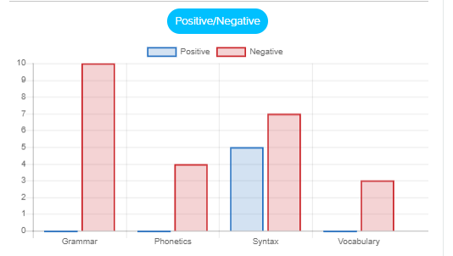
VEO https://veo.co.uk/
https://app.veo.co.uk/#/video/55941///50691

Slide 14
References
Lantolf, J.P. (Ed.). (2000). Sociocultural Theory and Second Language Learning. Oxford: Oxford University Press.
Leontiev, Аlexei А. 2001. “Kluchevye idei L.S. Vygotskogo–vklad v mirovuiu psikhologiiu XX stoletiia.” Preface in L.S. Vygotsky. Psikhologiia razvitiia cheloveka. Moscow: Izdatel’stvo Smysl, 4–10.
Vygotsky, L.S. (1986). Thought and Language. Cambridge, MA: MIT Press.
Vygotsky, L.S. (1987). Thinking and Speech. In The Collected Works of L. S. Vygotsky.Vol. 1. Problems of General Psychology. R. W. Rieber and A. S. Carton (Eds.). New York: Plenum.
Vygotsky, L.S. (1997). The History of the Development of Higher Mental Functions. In The Collected Works of L. S. Vygotsky. Vol. 4. The History of the Development of Higher Mental Functions. R. W. Rieber (Ed.). New York: Plenum.

