Slide 1
Empirical teaching of culture: Developing Cultural Knowledge through Cultural Scenarios in the Flagship Culture Initiative
Karen Evans-Romaine and Gulnara Glowacki
University of Wisconsin – Madison
22 April 2021

Slide 2
Preparation for Russian Overseas Flagship
Eight domestic Russian Flagship programs: Bryn Mawr College, Indiana University, Portland State University, UCLA, University of Georgia, University of North Carolina at Chapel Hill, University of Wisconsin – Madison
Domestic coursework in advanced Russian, coursework or tutoring in Kazakh, “Intercultural Introduction to Kazakhstan course” at UW-Madison

Slide 3
About the Flagship Culture Initiative (FCI)
Empirically grounded, scenario-based curriculum development project in multiple languages: Intercultural Learning at the Advanced and Superior Levels in Transnational and Transregional Contexts.
Integrate intercultural learning into domestic and overseas curricula of Language Flagship programs.
Languages included: Arabic, Portuguese, Russian (Chinese on a separate grant)
Two models: online Culture App (domestic) and roundtables (overseas)
FCI also supported bilingual Cultura-style online cultural exchange for Russian
Notes:
Dianna

Slide 4
Flagship Culture Initiative Domestic Partners
Core Domestic Partners for Russian
American Councils for International Education
Portland State University
Flagship Technology Innovation Center at the University of Hawai‘i at Mānoa
University of Maryland (PI Valerie Anishchenkova, UMD Arabic Flagship)
University of Wisconsin-Madison
*Grant to UMD, 2017-2020

Slide 5
ACTFL Statement on Global Competence
Global competence is the ability to:
Communicate in the language of the people with whom one is interacting.
Interact with awareness, sensitivity, empathy, and knowledge of the perspectives of others.
Withhold judgment, examining one’s own perspectives as similar to or different from the perspectives of people with whom one is interacting.
Be alert to cultural differences in situations outside of one’s culture, including noticing cues indicating miscommunication or causing an inappropriate action or response in a situation.
Act respectfully according to what is appropriate in the culture and the situation where everyone is not of the same culture or language background, including gestures, expressions, and behaviors.
Increase knowledge about the products, practices, and perspectives of other cultures.

Slide 6
Objectives
Intercultural competence in the Flagship context: addressing our students’ needs.
Bridging cultural preparation at home with in-culture experiences during study abroad.
Promoting learner’s independence and self-guidance, as well as a deeper understanding of one’s own cultural ”lens”/worldview.
Developing a method allowing for high degree of adaptability.
Notes:
Languaculture (Agar, 1994; Risager, 2006, 2007)
Add line about reflection on home cultural values

Slide 7
Why Scenarios?
Designed as ”conversation starters.” Multiplicities of understanding, interpretation.
Address topics, “issues” of salience for specific groups of students.
Allow for highly contextualized examples of interactions.
Facilitate articulation between domestic and study abroad programs
Allow for integration into different types of learning activities and different learning outcomes
Student positionality: observer, participant
Notes:
Languaculture (Agar, 1994; Risager, 2006, 2007)

Slide 8
Why these topics?
American Councils conducted a “360 ICC-Survey” with overseas Flagship programs in Arabic, Chinese, and Russian, including both surveys and focus groups
We drew on conversations with our UW-Madison students and alumni over the years of their participation in Russian Overseas Flagship and previous study abroad

Slide 9
Two Settings for FCI Scenarios: Classroom and Workshop
Classroom, UW-Madison:
“Intercultural Introduction to Kazakhstan” course (one credit), taught in Russian to advanced students prior to the Russian Overseas Flagship
Small-group discussion-based format
Online Workshop, hosted by UW-Madison:
Three-day workshop immediately prior to start of ROF, August 2020 and 2021
Small-group, discussion-based format

Slide 10
Culture App: Russian Online Cultural Scenarios
71 scenarios, in Russian and in English
Structure: Modules → Topics → Scenarios
Modules:
Classroom Interactions: 20
Homestay: 25
City Life: 16
Internship and Workplace: 10

Slide 11
Russian Online Cultural Scenarios: Classroom
Classroom Interactions Topics:
What’s in a name?
Greetings and Goodbyes
Office Hours and Consultations
Instructor-Student Relations
Classwork and Feedback in Class
Eating and Drinking in Class
Extenuating Circumstances

Slide 12
Russian Online Cultural Scenarios: Homestay
Homestay Topics:
Food and Meals
Personal Space
Taking Advice from Elders
In the Kitchen
Apologies and Thanks
Discussing (or Avoiding) Sensitive Topics

Slide 13
Russian Online Cultural Scenarios: City Life
City Life Topics:
Public Transit: safety and etiquette: bus, minibus, taxi, private taxi
Public Places:
Cloakroom Etiquette
Line Etiquette
Check, please! Restaurant bills and invitations
Let me help you! Offering and accepting help from neighbors
Public Monuments: etiquette and discussion of complex historical topics

Slide 14
Russian Online Cultural Scenarios: Workplace
Workplace Topics:
Greetings and Introductions
Workplace Invitations and Celebrations
Getting Work Done: Workplace Assignments
Discussing (or Avoiding) Sensitive Topics at Work

Slide 15
Russian Online Cultural Scenarios: Structure
Topic level:
Reflective questions before and after each topic: how do you handle this issue at home? How do this situation and possible outcomes compare with what you are used to? What values might underlie outcomes?
Russian discussion of values and practices underlying these scenarios
Learning Objectives

Slide 16
Russian Online Cultural Scenarios: Structure
Russian-language scenarios targeted at the Intermediate High/Advanced levels
Scenario structure and language:
Introductory material
“priming” questions and post-scenario reflection questions
introductory cultural material at the Topic and Scenario levels in both English and Russian
Context set in English
Culture notes in Russian
Language notes in Russian with English-language definitions of words and expressions as needed, relevant to the scenario
Vignette (situation, scenario), Judgment Task, and Feedback all in Russian

Slide 17
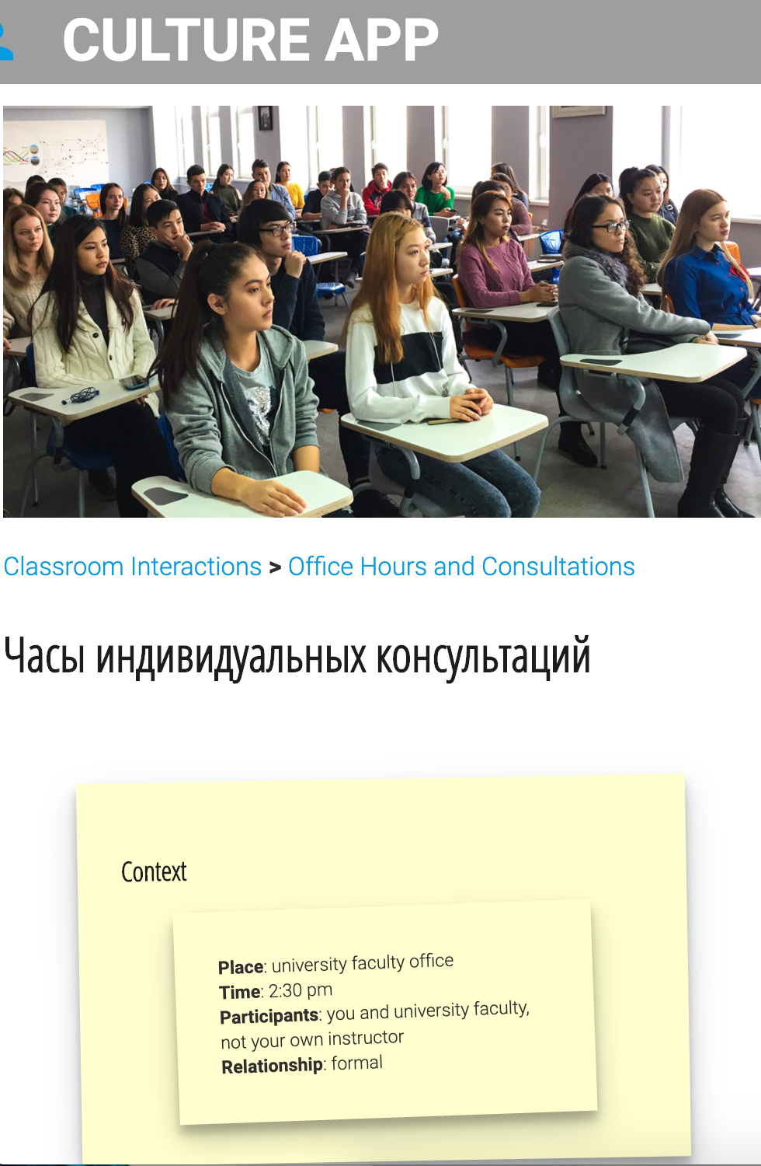
Notes:
Stephen

Slide 18
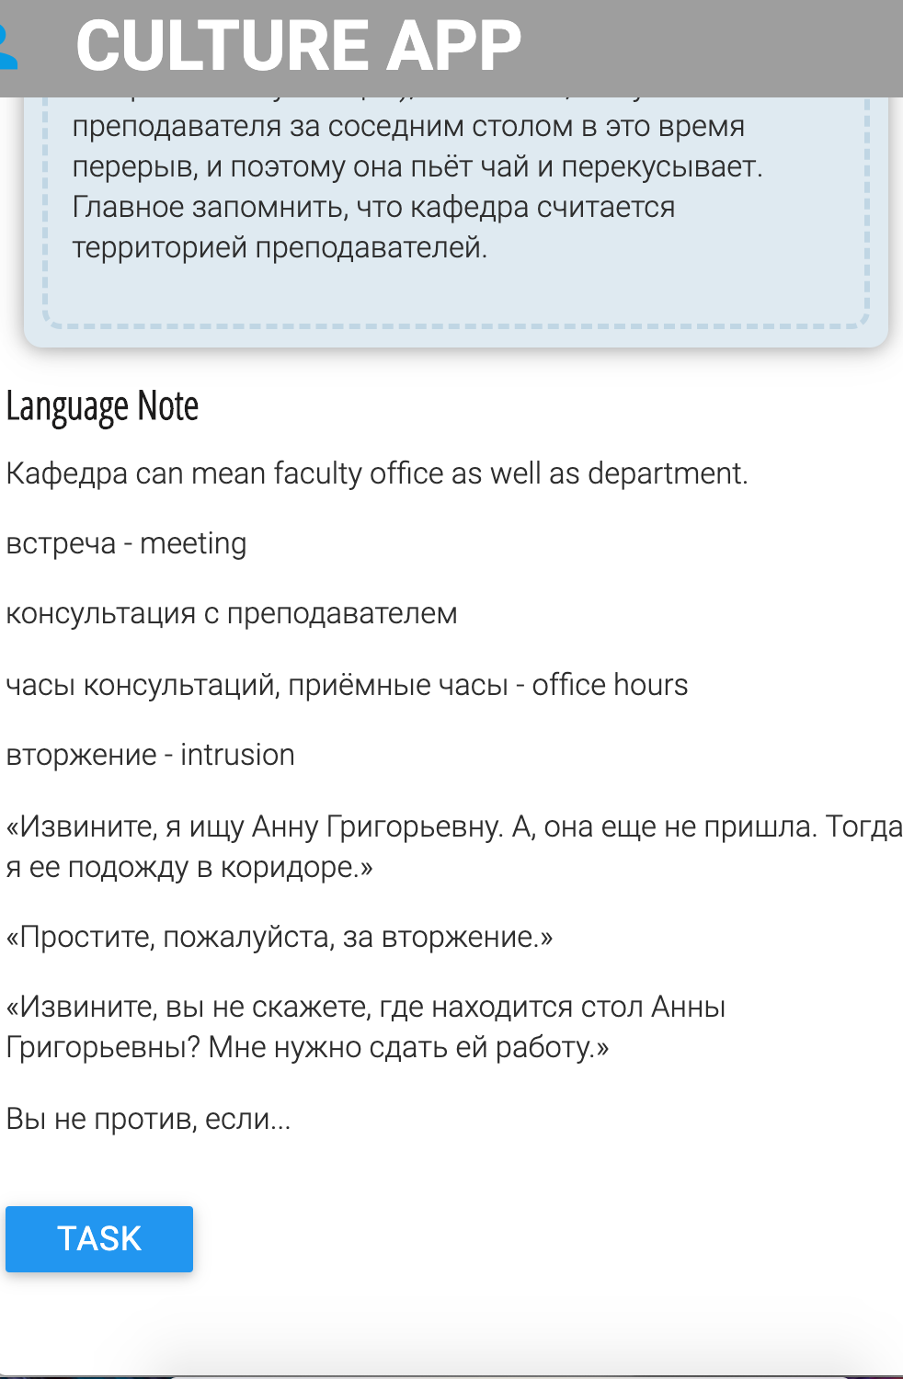
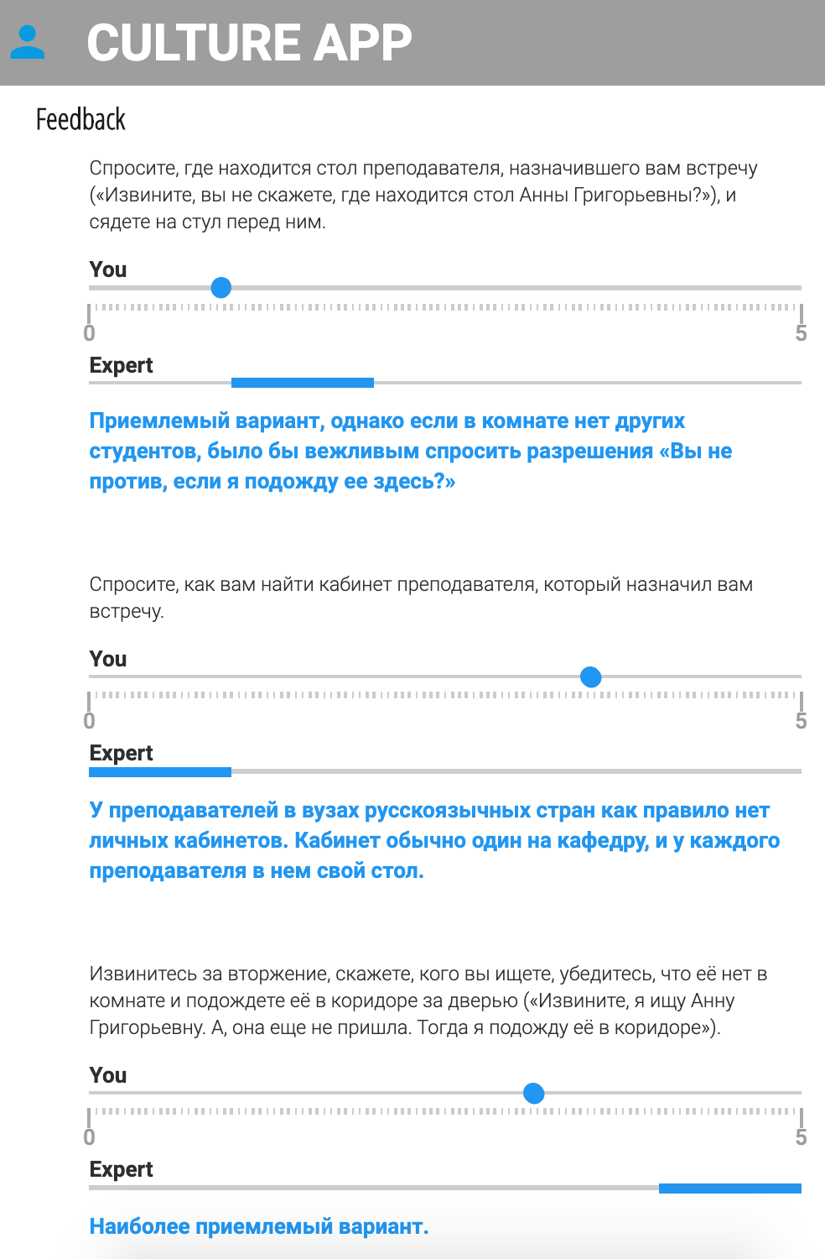
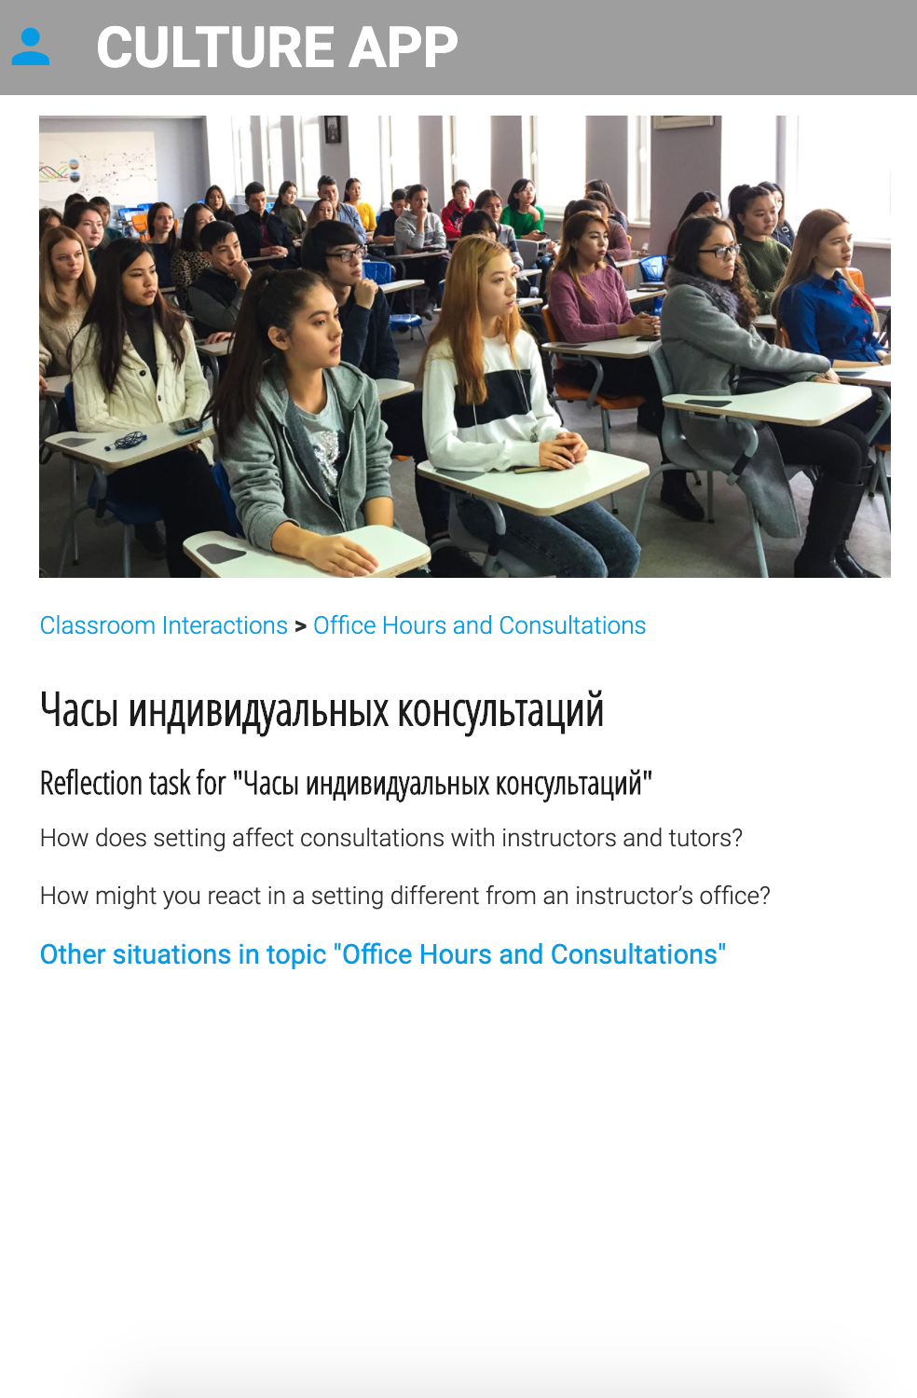
Notes:
Stephen

Slide 19
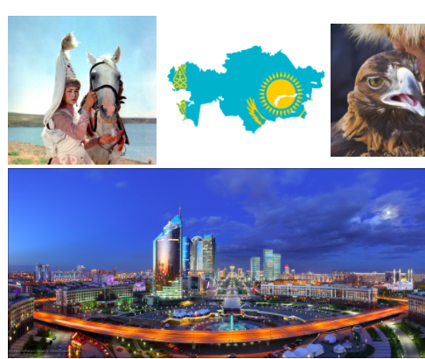
Teaching the FCI Scenarios
Prior to the
Russian Overseas Flagship
Gulnara Glowacki, University of Wisconsin – Madison
Caption

Slide 20
Intercultural Introduction to Kazakhstan course, 2019
Course based on:
a series of online modules on the history and cultures of Kazakhstan
an online intercultural exchange with students at Nazarbayev University in Astana
on online cultural scenarios in the overseas classroom and homestay contexts.

Slide 21
Scenario techniques: how we taught them
Reading and analyzing homework
Reading and discussing in classroom
Working together
Working in small groups
Working independently

Slide 22
Scenarios that provoked the most discussion among students:
Classroom Interactions
Homestay
City Life
Workplace

Slide 23
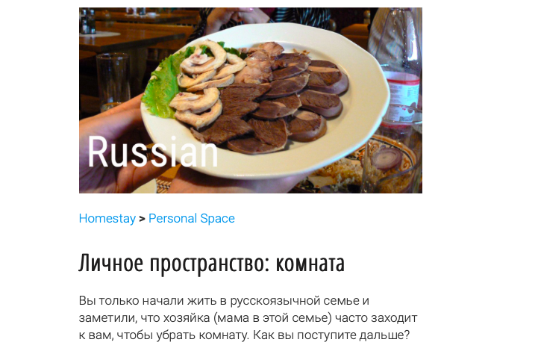
Personal Space

Slide 24
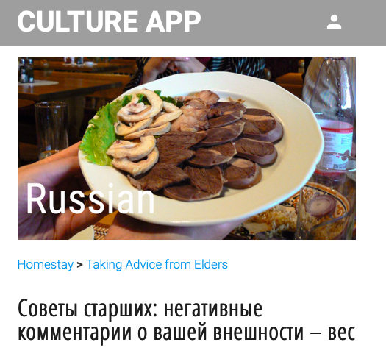
Talking Advice from Elders
Caption

Slide 25
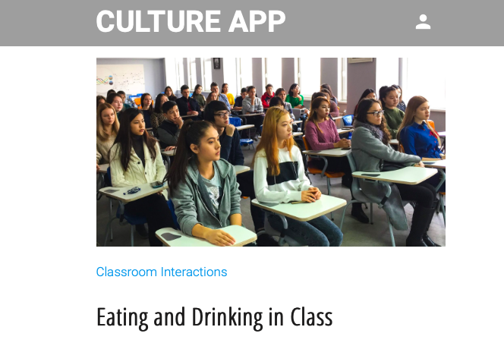
Eating and Drinking in Class
Caption

Slide 26
Restaurant: Who pays the bill?

Slide 27
Discussing (or Avoiding) Sensitive Topics

Slide 28
Many thanks to our FCI colleagues!
Valerie Anishchenkova, University of Maryland (FCI project PI)
Dianna Murphy, University of Wisconsin – Madison
Joseph Bass, University of Maryland
Dan Davidson, American Councils, director of FCI 360 ICC-Survey
Maria Lekic, American Councils, academic director of Russian Overseas Flagship program and author of Russian Cultural Roundtables conducted during ROF
Julio Rodriguez, Stephen Tschudi, Dmitrii Egorov, Russ Suvorov, and the Flagship Technology Innovation Center at the University of Hawai‘i at Mānoa

Slide 29
Many thanks to FCI Russian scenario team!
FCI Russian scenario authors: Karen Evans-Romaine, Gulnara Glowacki, SA Karpukhin, Moldir Oskenbay
FCI Russian scenario consultants: William J. Comer, Dianna Murphy, Olga Permitina, Anna Tumarkin
FCI Russian scenario reviewers
Anna Alsufieva, Portland State University
Thomas Jesús Garza, University of Texas at Austin
Alex Groce, American Councils
Susan Kresin, University of California, Los Angeles
Moldir Oskenbay, University of Wisconsin – Madison
Olga Thomasson, University of Georgia
Victoria Thorstensson, Nazarbayev University

Slide 30
Many thanks for inspiration to the FCI! Mary Margaret Wang et al. Turning Bricks into Jade. Critical Incidents for Mutual Understanding among Chinese and Americans. Boston: Intercultural Press, 2000.

Slide 31
Discussion
What cultural issues do your students find the most challenging?
How might you use these scenarios in your program?
How do I find the scenarios? https://thelanguageflagship.tech/fci-russian/

Slide 32
Questions?

