Slide 1
Learner-Centered Classroom: Teaching Students of Different Majors
Project-Based Learning
Flagship Teacher Training Workshop
April 19, 2021
Svitlana Melnyk
Indiana University

Slide 2
Curriculum: Content Based Courses
Russian Political Culture
Business Russian
Russian for the Social Sciences
Contemporary Russian Culture
Russian Modernism
Contemporary Russia in Film, Literature, and Art
Russian Mass Media
Russian Through Literature

Slide 3
How to create a learner-centered classroom?
- content-based courses
- varied topics
- student voice & choice
- student presentations
- task-based activities (mock job interview, Shark Tank)
- final paper (курсовая работа) and final presentation (защита)
- projects (Wikipedia, podcasts)

Slide 4
What is PBL?
“Project Based Learning is a teaching method in which students gain knowledge and skills by working for an extended period of time to investigate and respond to an authentic, engaging, and complex question, problem, or challenge”
http://www.bie.org/about/what_pbl

Slide 5
Benefits of PBLL
improving language skills and motivation for studies (Beckett & Miller, 2006)
improving communication and problem-solving skills (Stoller and Myers, 2019)
increasing job satisfaction (Hixson, Ravitz, & Whisman, 2012)

Slide 6
Gold Standard PBL: Essential Project Design Elements
Challenging problem or question
Sustained inquiry
Authenticity
Students’ voice and choice
Reflection
Critique and revision
Public product
http://www.bie.org/about/what_pbl

Slide 7
Thank you, Veronika Trotter!

Slide 8
Why Wikipedia? advantages and disadvantages
Largest source of information
Free
Constantly updated
Anybody can edit it
Anybody can edit it
Not scholarly
Quality of the articles vary significantly
Information is not always verified

Slide 9
Project stages
List of sources and outline (10 points)
1st draft (25 points)
First Draft Peer Review (5 points)
Final version of the article (20 points)
Uploading/creating the page on Wikipedia (10 points)
Mini-conference: final oral presentation (30 points)
Final product: 19 Wikipedia pages
О́ливер Джон Го́лден
Гарри Хейвуд

Slide 10
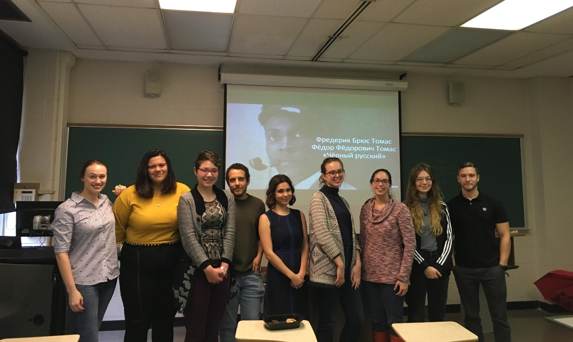
Students’ testimonials
I thought this project was useful in enhancing my Russian language skills, my understanding of how Wikipedia works + my research skills.
I really enjoyed learning about the topic and people.
It was an interesting experiment.
Learning about unknown-to-me subject.
Learning to use technical language in Russian.
I think it was very useful in synthesizing all the aspects of language learning (presenting, writing, translating, finding sources, adjusting to a new style, etc.).
Learning about an otherwise unknown person.
I liked that we created a concrete project which I could show to people.
I enjoyed doing research in Russian about a person who is not very well known.
Students from the “Russian for Social Sciences” class

Slide 11
What projects can you do in your class?
Beginner level (poster for a language event (festival); wall newspaper; creation of material for a local school, community event (picnic or fundraising); promotional video in the target language)
Intermediate level (language event in a local school; booklet in target language about university, department, town; interviews with members of local community; poetry reading)
Advanced level (podcasts; community events; website creation; video; theatrical performance)
More ideas: Stoller & Myers, 2020

Slide 12
Project based learning improves language skills and motivation for studies
Students gain new specific knowledge through the target language
They improve their research skills and communication skills
They increase their satisfaction from language learning through creation of socially meaningful product

Slide 13
Further reading about PBLL:
Beckett, Gulbahar H., and Tammy Slater, eds. Global Perspectives on Project-Based Language Learning, Teaching, and Assessment: Key Approaches, Technology Tools, and Frameworks. New York: Routledge, 2019.
Gras-Velázquez Adrián, ed. Project-Based Learning in Second Language Acquisition: Building Communities of Practice in Higher Education. New York: Routledge, 2020.
Stoller, Fredricka L., and CeAnn Chandel Myers. “Project-Based Learning: A Five-Stage Framework to Guide Language Teachers.” In Project-Based Learning in Second Language Acquisition: Building Communities of Practice in Higher Education, edited by Adrián Gras-Velázquez, 25–47. New York: Routledge, 2020.
PBL Institutions:
The Buck Institute for Education
National Foreign Language Resource Center
Thank you!

