Slide 1
Increasing students' oral production: Effective elicitation techniques and appropriate activities across proficiency levels
Evgeny Dengub
University of Massachusetts Amherst
2021

Slide 2
Proficiency
The ability to use a language to communicate meaningful information in a spontaneous interaction, and in a manner acceptable and appropriate to native speakers of the language.

Slide 3
Five Questions
Why? Function
What? Content
Where? Context
How (well?) Accuracy
How much? Text Type
Notes:
Every new level represents a new constellation of interrrelationships (Higgs) between these criteria

Slide 4
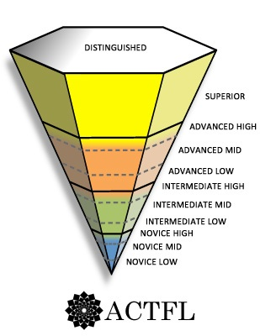
Can support opinion, hypothesize, discuss topics
concretely and abstractly, and handle a linguistically unfamiliar situation.
Superior
Can narrate and describe in all major time frames and handle a situation with a complication
Advanced
Can create with language, ask and answer simple questions on familiar topics, and handle a simple situation or transaction
Intermediate
Novice
Can communicate minimally with formulaic and rote utterance, lists and phrases

Slide 5
Superior
Advanced
Intermediate
Novice

Slide 6
Function
Superior | Support opinions and hypothesize
Advanced | Narrate and describe in all major frames and deal with an unanticipated complication
Intermediate | Create with language, ask and answer simple questions, handle a simple routine situation
Novice | Produce lists
Notes:
Function is the most crucial element in oral proficiency assessment

Slide 7
Content and context
Superior | Wide range of public-interest topics / informal and formal settings
Advanced | Topics of personal and general current interest / informal and some formal settings
Intermediate | Predictable, familiar topics / Informal settings
Novice | Most common aspects of daily life /Most common informal settings

Slide 8
Accuracy
Number of mistakes
Comprehensibility, precision and acceptability of the message conveyed.
How well a speaker is understood.
The degree to which the speaker relies on the listener to complete the message.
Notes:
Effective communication

Slide 9
Accuracy
Superior | No pattern of errors
Advanced | Can be understood without difficulty by “un-sympathetic” speakers
Intermediate | Can be understood by “sympathetic” listeners
Novice | Difficult to understand, even for “sympathetic” listeners
Notes:
Accuracy for work?

Slide 10
Degrees of Control
Full
Partial
Conceptual

Slide 11
Text Type
Superior | Extended discourse
Advanced | Paragraphs
Intermediate | Sentences and strings of sentences
Novice | Words, phrases, lists

Slide 12
Уровень студента
CEILING
FLOOR
Notes:
Чтобы быть Mid или High, нужно обязательно уметь делать что-то из предельного уровня

Slide 14
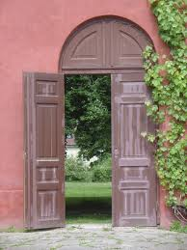
Yes/No Questions

Slide 15
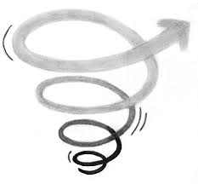
Spiraling the topic
Ceiling
Floor

Slide 16
Искусство вопросов
The simpler the better: Не могли бы вы сказать, в чём, по-вашему мнению, основные отличия двух столиц: Москвы, с одной стороны, и Санкт-Петербурга, с другой?
Paraphrasing helps but not always. Give them time to think!
Focus on communication and learning, and NOT on the ‘correct’ answers.

Slide 17
Use more..
Почему?
Как?
Расскажите мне о…
Notes:
Yes, no questions vs Explain, tell me.

Slide 18
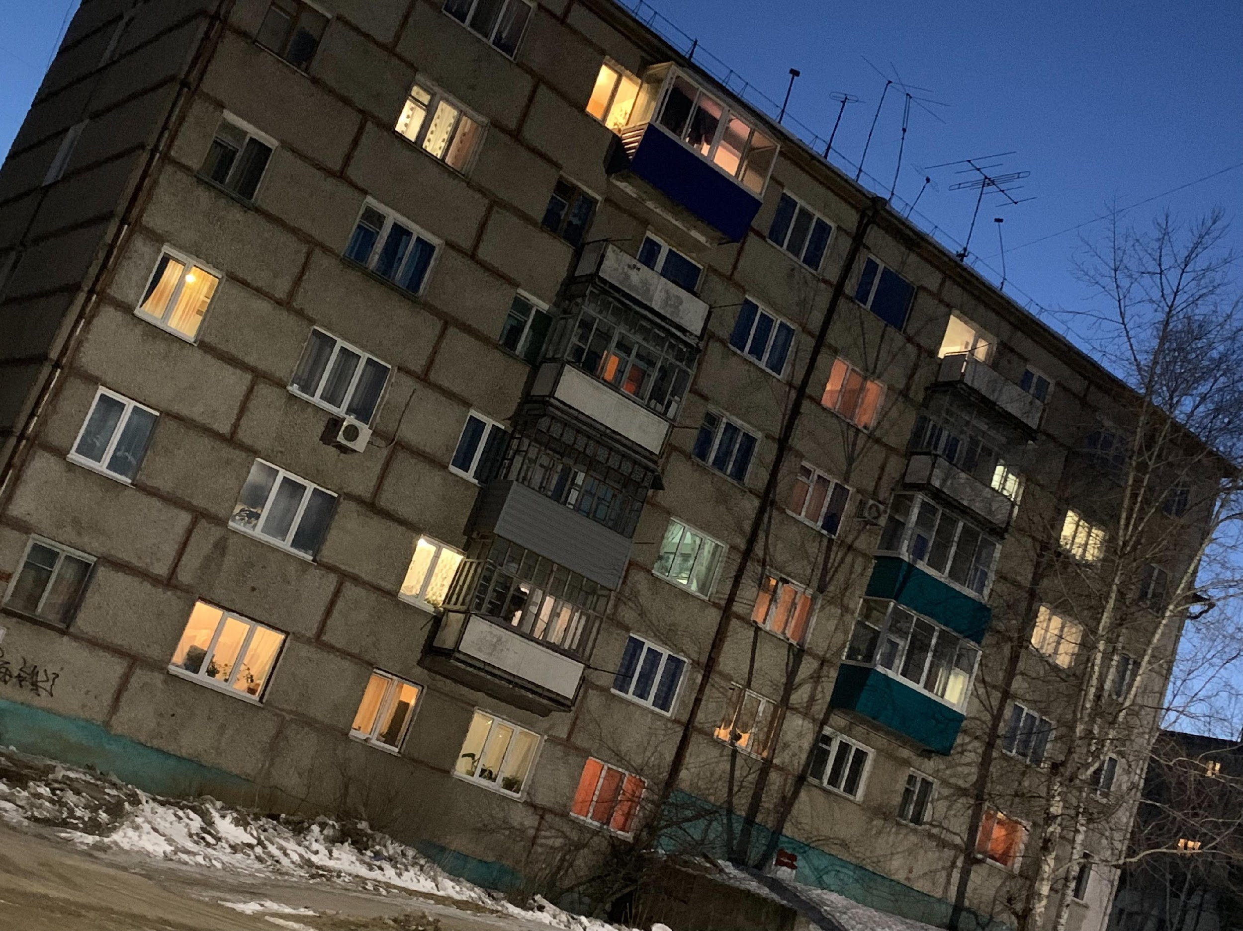
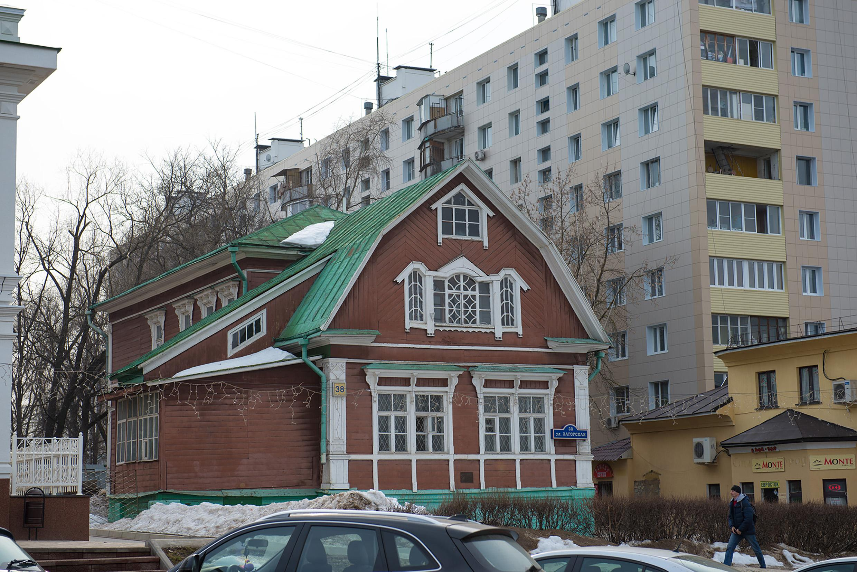
Тема: дом
Intermediate
Где вы хотите жить?
В каком районе ваш дом? Опишите этот район.
Расскажите о своём доме. Какой он?
Вам нравится ваш дом? Почему?
Какие комнаты/какая мебель у вас в доме?
Novice
Notes:
Чтобы быть Mid или High, нужно обязательно уметь делать что-то из предельного уровня

Slide 19
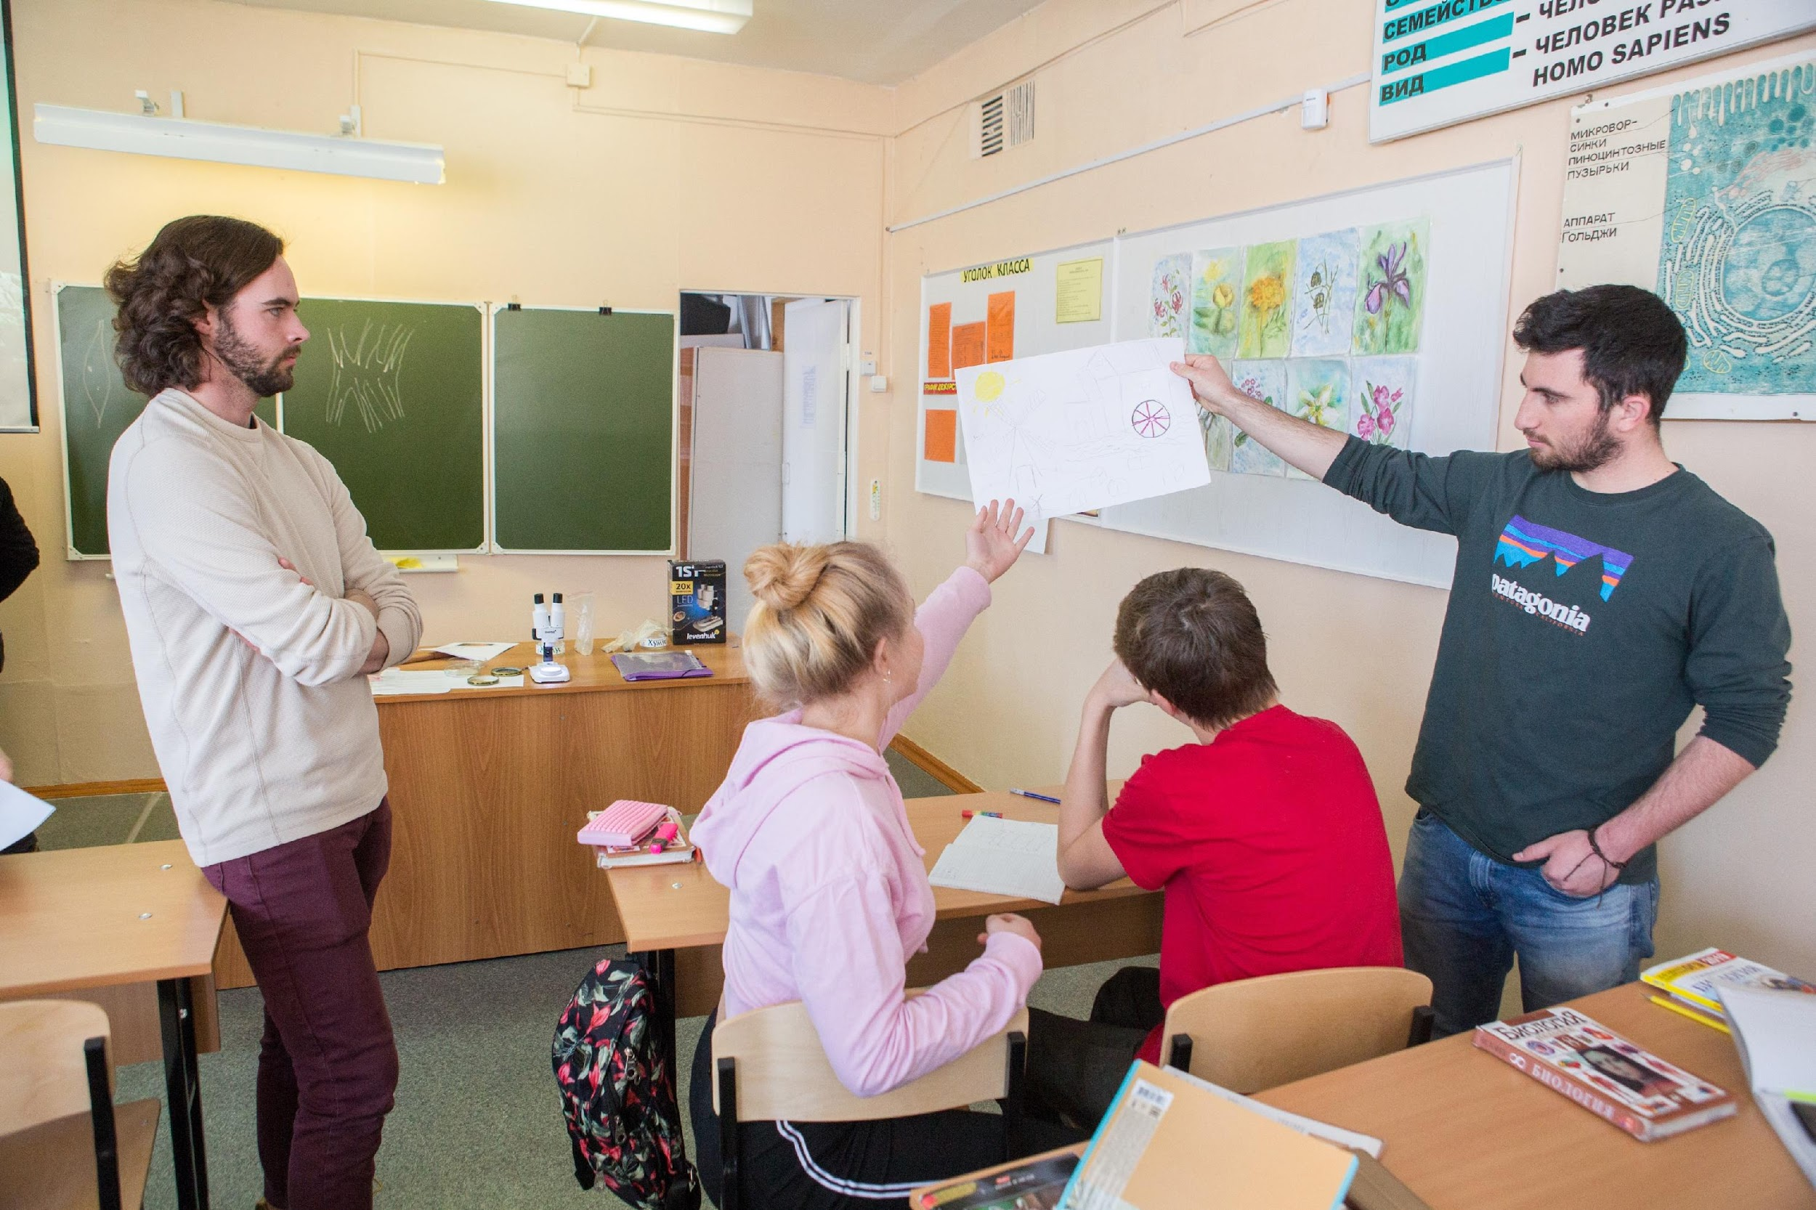
Тема: учёба
Промежуточный
Базовый
Notes:
Чтобы быть Mid или High, нужно обязательно уметь делать что-то из предельного уровня

Slide 20
Тема: дом
Advanced
Как изменилось жильё за последние 30-40 лет?
Сравните ваше нынешнее жильё с домом детства.
Что вы будете делать, чтобы купить/снять дом?
Как вы купили/нашли свой дом? Расскажите об этом.
Расскажите о своём доме. Какой он?
Intermediate
Notes:
Чтобы быть Mid или High, нужно обязательно уметь делать что-то из предельного уровня

Slide 21
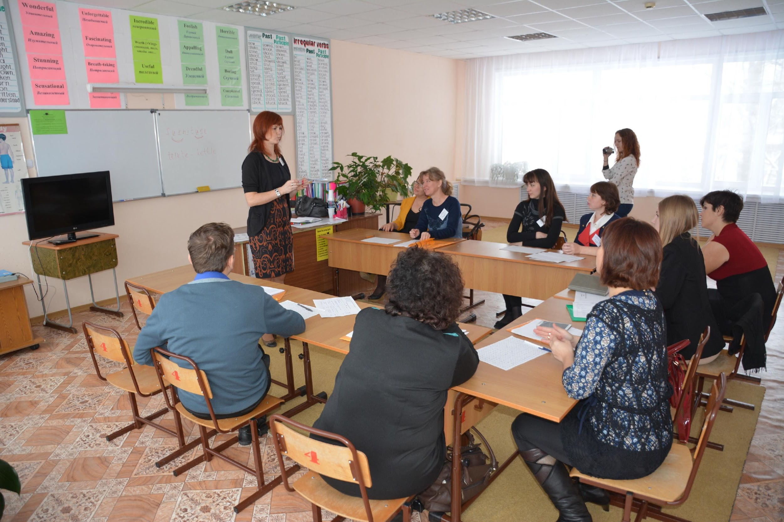
Тема: учёба
Advanced
Intermediate
Notes:
Чтобы быть Mid или High, нужно обязательно уметь делать что-то из предельного уровня

Slide 22
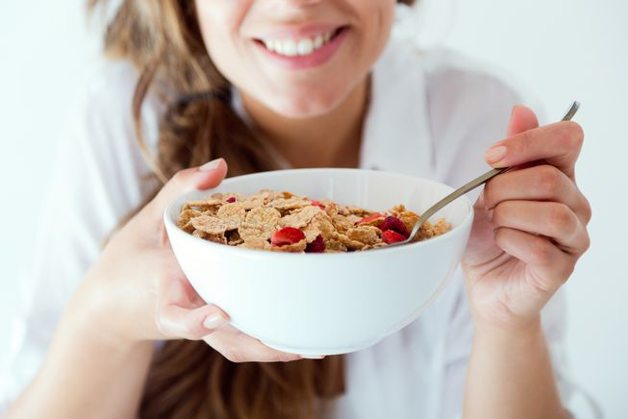
Тема: еда
Advanced
Intermediate
Novice
Notes:
Чтобы быть Mid или High, нужно обязательно уметь делать что-то из предельного уровня

Slide 23
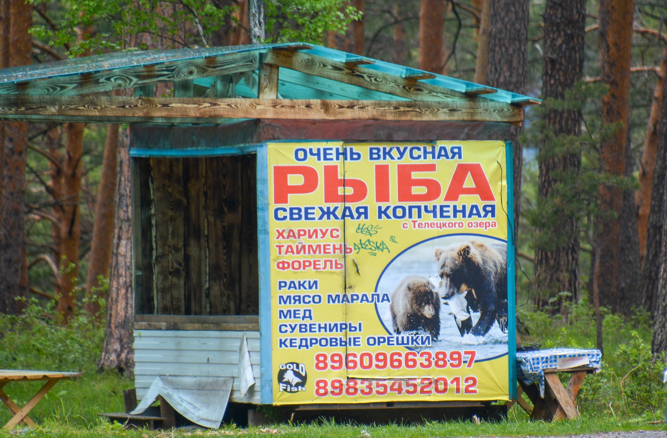
Тема: еда
Advanced
Intermediate
Novice
Notes:
Чтобы быть Mid или High, нужно обязательно уметь делать что-то из предельного уровня

Slide 24
Ask your partner if they prefer:
Кофе или чай? coffee or tea
Автобус или метро? bus or subway
Водка или вино? vodka or wine

Slide 25
4th week of classes
Imagine that you are moving to Санкт-Петербург and you are looking for different housing options. You can rent a room or an apartment. On the site X, find one good option in each category.
Once you have three good options, record a voice mail to a friend with a short description of each place.
Your description should include the location, what the place has, and contact phone number

Slide 26
List (Novice) words and phrases
What are the rooms in your house?
What clothes do you have?
What colors do you know? Read….,
What subjects do you study at school?
What do you have in you room?
What do you see now?

Slide 27
Creative use of language (Intermediate) sentences and strings of sentences
Why do you like X?
Tell me about Y.
What do you usually do after/before Z?
Tell me about your typical day.
What do you usually do in your Q class?

Slide 28
Narration (Advanced) paragraph
Tell me about an interesting story that happened to you in …
Tell me about your trip to X in detail.
Tell me in detail about you future visit to Y.
How did you start doing Z?
How was your last/first/most exciting day in Q?

Slide 29
Description (Advanced) paragraph
Describe your campus library in detail.
How does X differ from Y?
Compare Z and Q.

Slide 30
Advanced: Teaching students to elaborate
“Describe in detail..”
“Say as much as you can…”
“From the beginning to end…”

Slide 31
Activities that reflect proficiency orientation the most
Pair and small group activities
Role plays and simulations
Information gap activities
Cooperative learning
Free writing
Cultural units
Birckbichler and Corl, 1993

